Slide 1


- SA22901880 -

Slide 2

CONTENT
1.Home Page
2.Products Page
3.Product Detail Page
4.About Us Page
5.Contact Us Page
6.Account Page
7.Cart Page

Slide 3


HOME PAGE : -

Slide 4

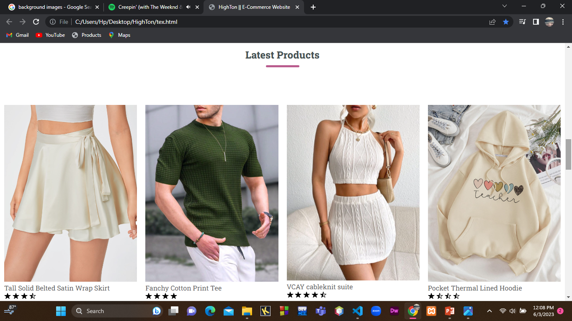
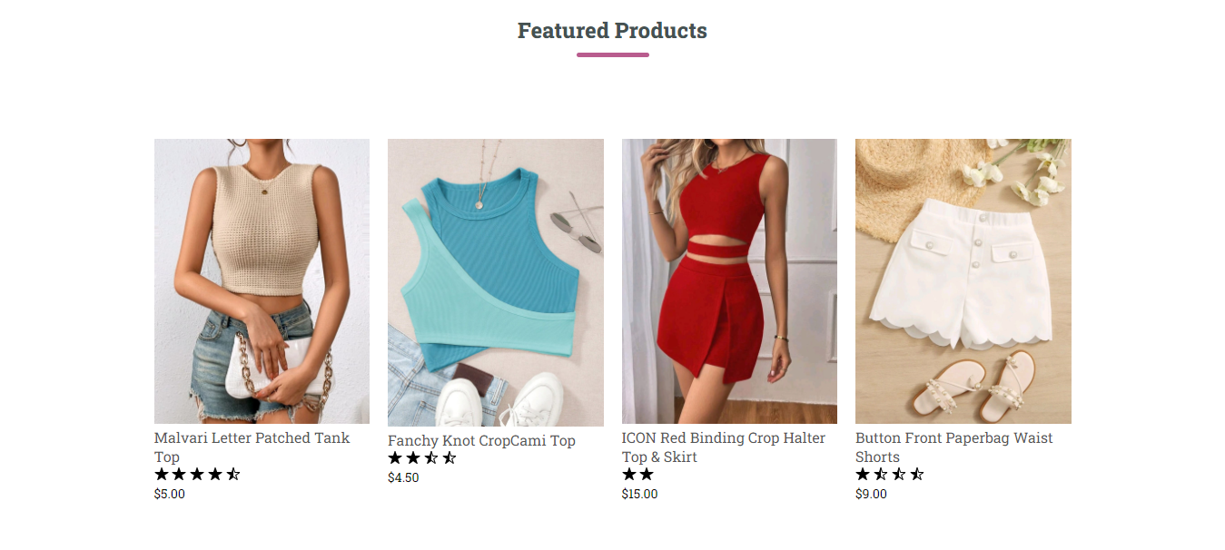
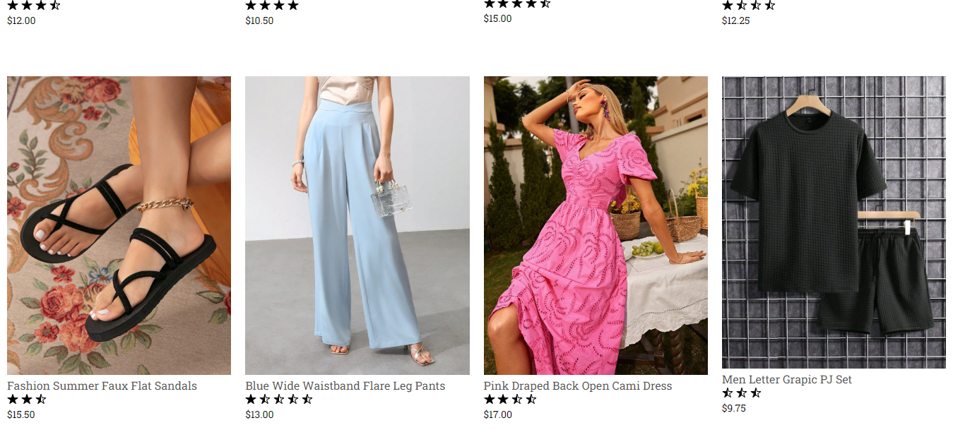

Slide 5




Slide 6

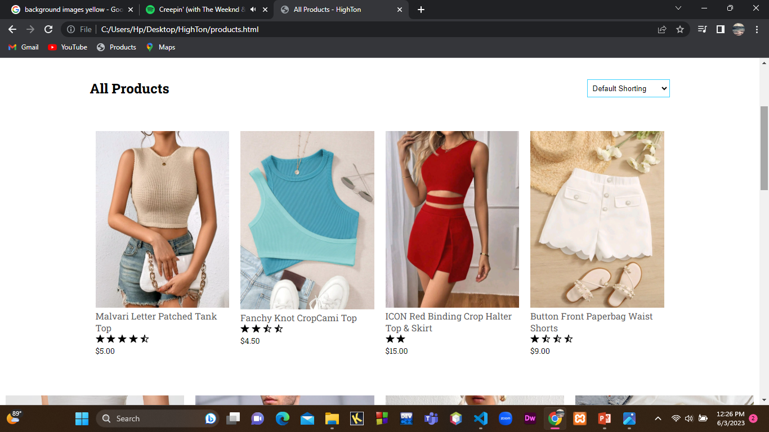
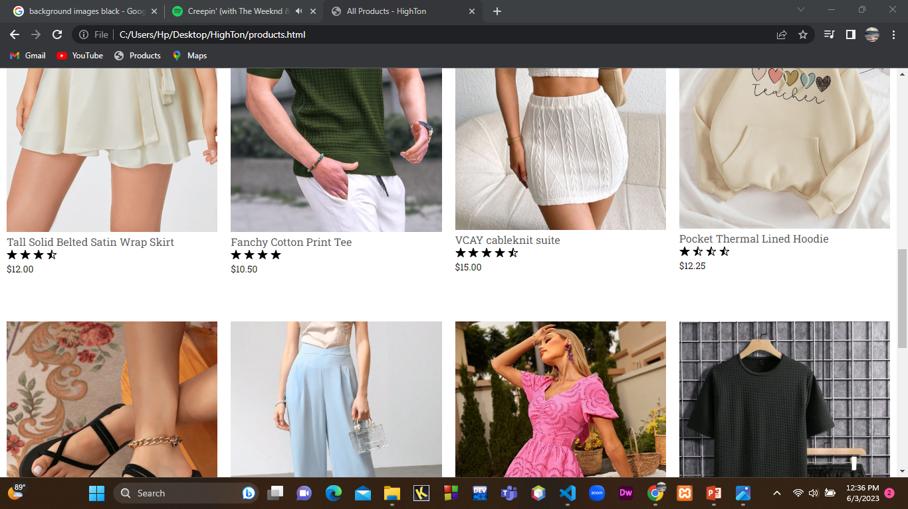
PRODUCT PAGE: -

Slide 7


ABOUT US PAGE :-

Slide 8

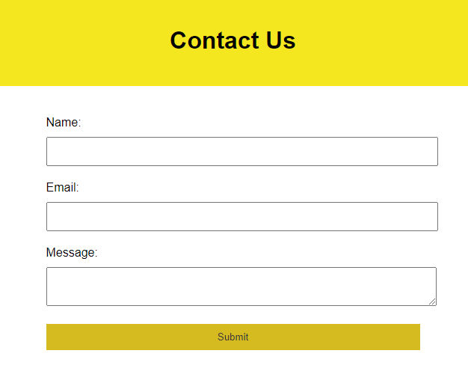

CONTACT US PAGE :-

Slide 9

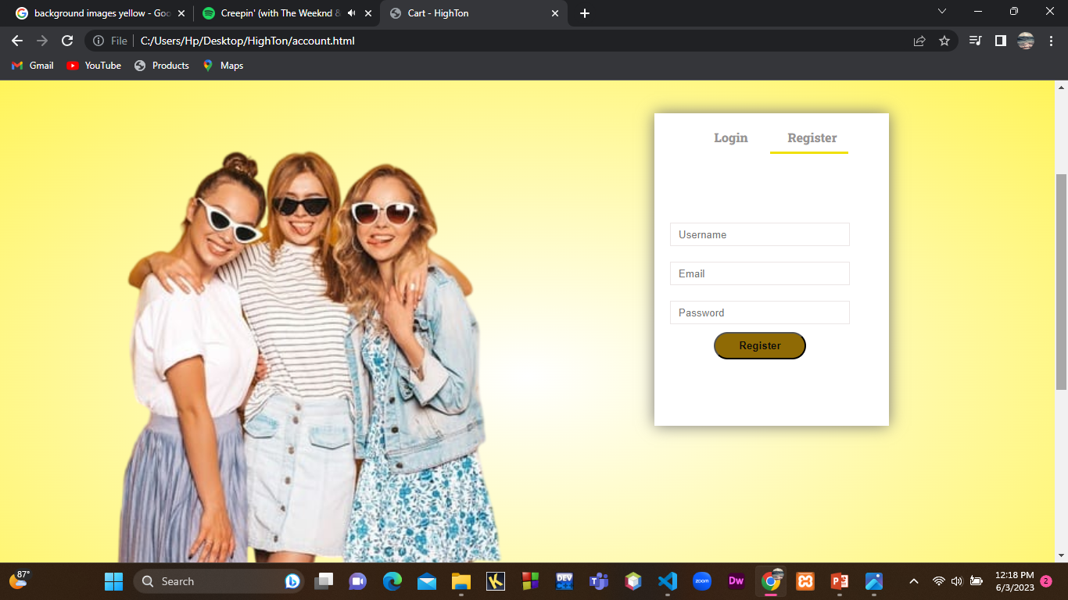
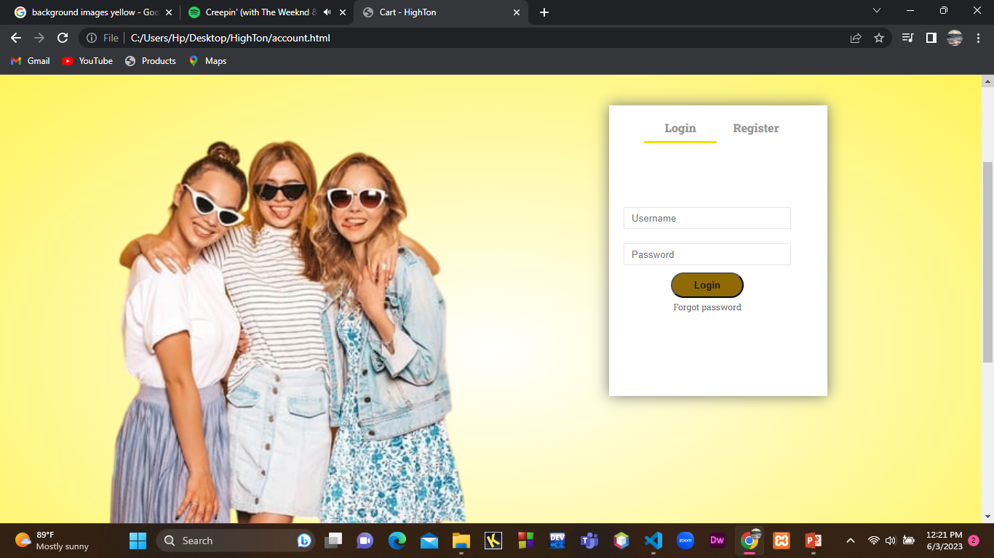
ACCOUNT PAGE :-

Slide 10

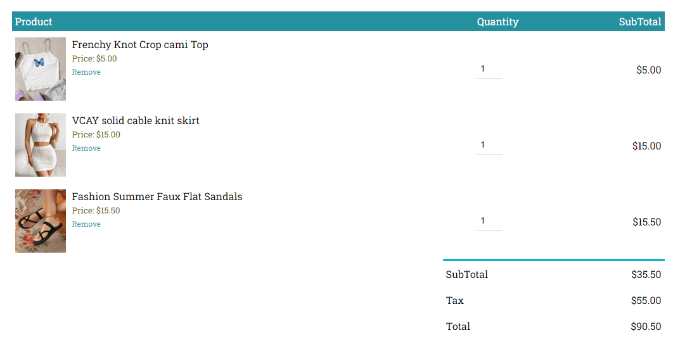
CART PAGE :-

Slide 11


